Slide 1
Lending Club case study
Submitted by: Prasad & Jitesh

Slide 2
Case Study Summary
Built understanding of the objective, different features and their data types
addressed the data quality issues including missing values, outliers and redundant features
Univariate analysis of categorial and continuous variables and their relationship with loan status
Derived new features from the data as per the domain understanding
Bivariate analysis and segmented analysis to understand the relationship between different features
Identified significant metrics in identifying default

Slide 3
Data Cleaning and manipulation
Dropped the features which have very low fill rate
Dropped the user behavior features which are not available before issuing the loan.
Converted the data types of the features as per relevance
interest rate, loan term and revol util to float from object
Date fields to date from object
Created new columns with interest bins and funded_amnt_inv bins, and DTI bins.
Missing value imputations

Slide 4
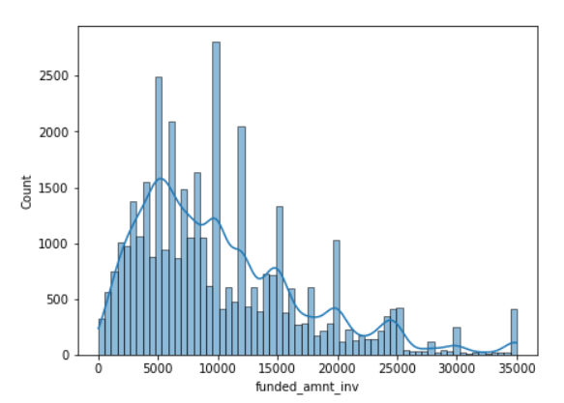
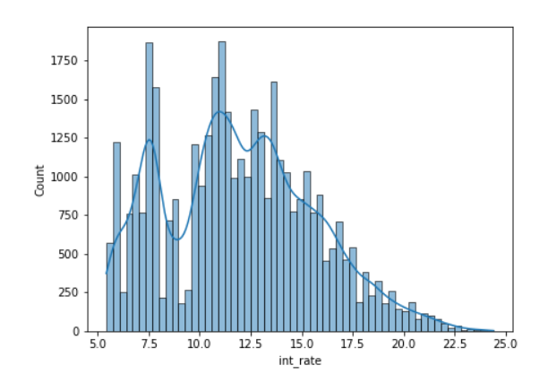
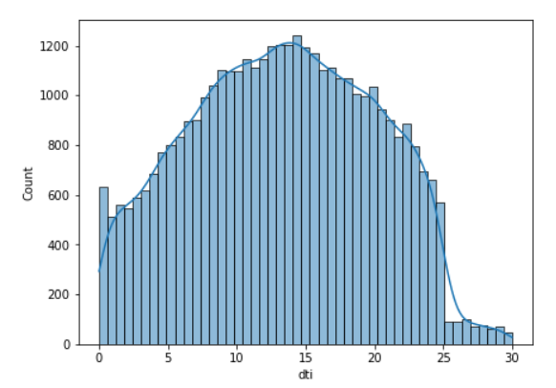
Univariate Analysis
Continuous variables
Highest distribution of Issued amount lies is between 5000 to 15000.
Highest distribution of Installment amount lies between 200 to 500.
Highest distribution of interest rate lies between 10 to 15.
Highest distribution of DTI lies between 8 to 18.
A lot of features are quite skewed including annual income.

Slide 5
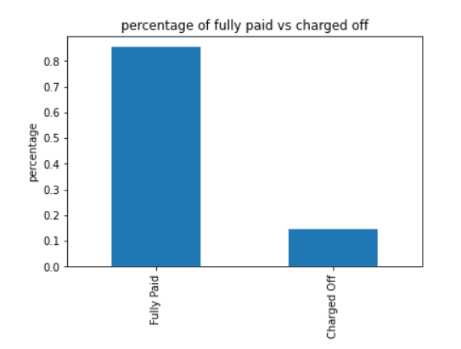
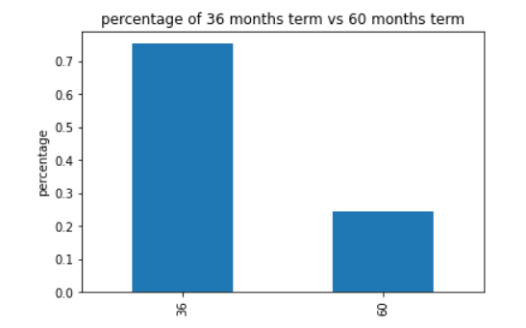
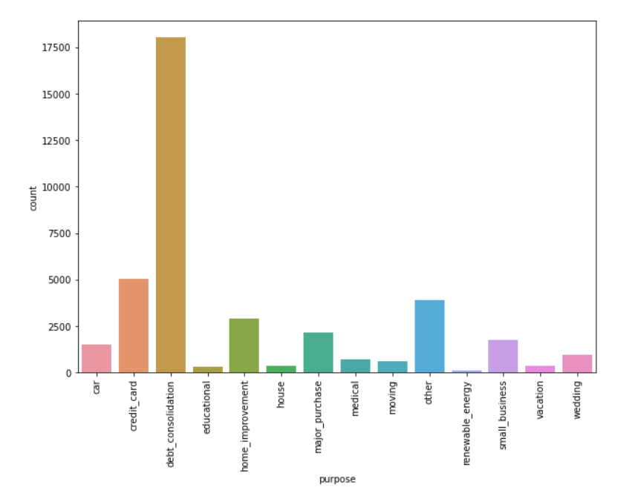
Univariate Analysis
Categorical Variables
There are around 15 percent charged off loans
76% of loans term is 36 months rest are 60 months.
Most number(~17500) of loans are taken for debt consolidation

Slide 6
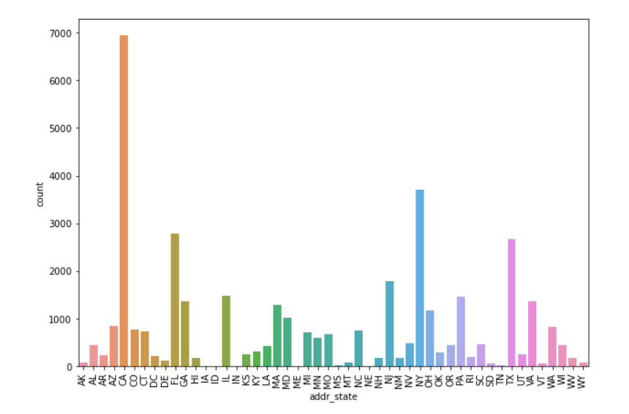
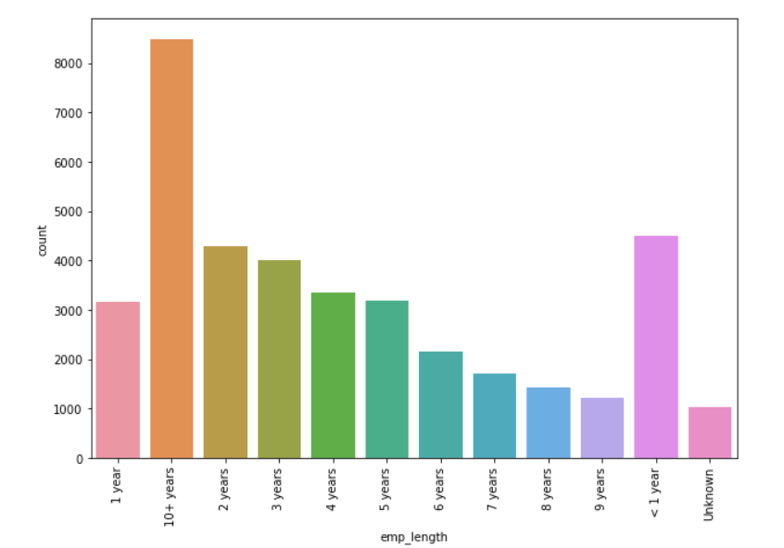
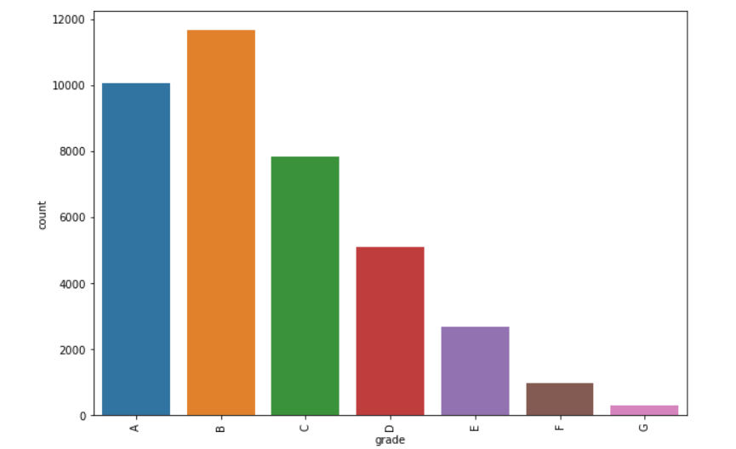
Univariate Analysis
Categorical Variables
States CA, NY, FL, Tx has highest number of loans.
Most number of loans are given to Grad A, B, C, D.
More number of loans are given to people with 10+ years, 1 year, 2 years experience respectively.

Slide 7
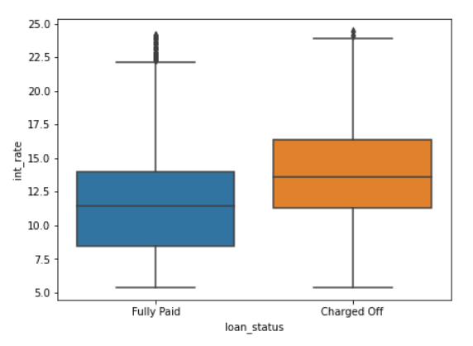
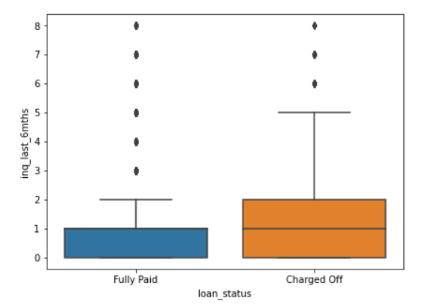
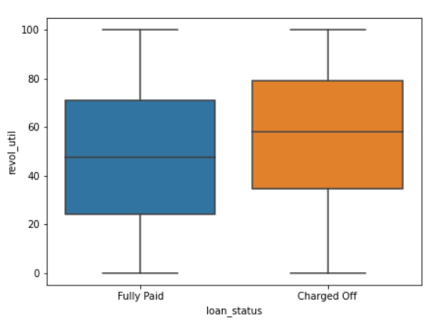
Bi-variate and Segmented analysis
On an average Charge off loans have higher rate of interest.
The Charged off loans have more inquiries compared to fully paid loans
Revolving line utilization rate is higher for charges off loans

Slide 8
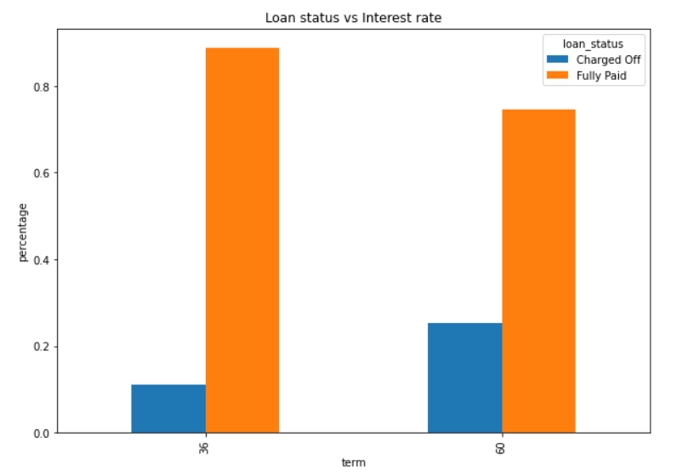
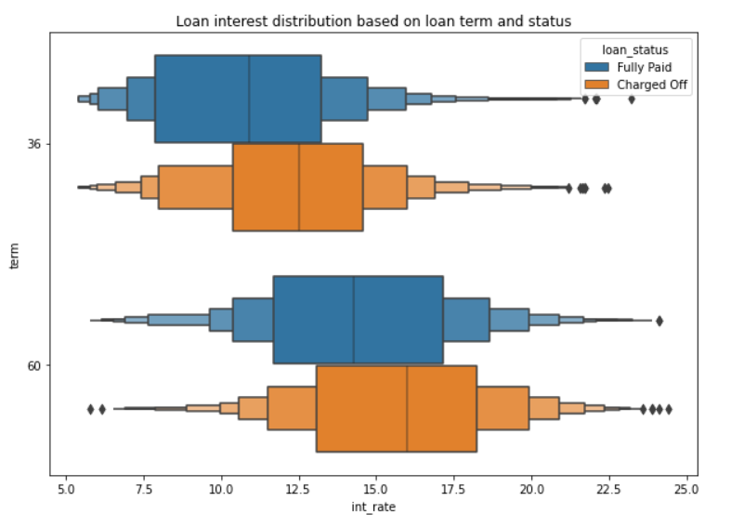
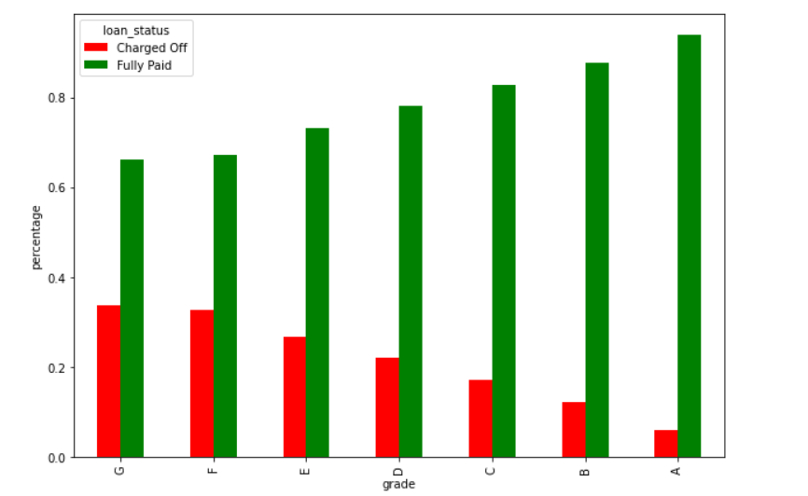
Bi-variate and Segmented analysis
If the loan term is 60 months then there is more chance of being charged off.
Interest rate is also higher for 60 months compared to 36 months term.
Grades E, F, and G have high-interest rates and percentages of charged-off loans.

Slide 9
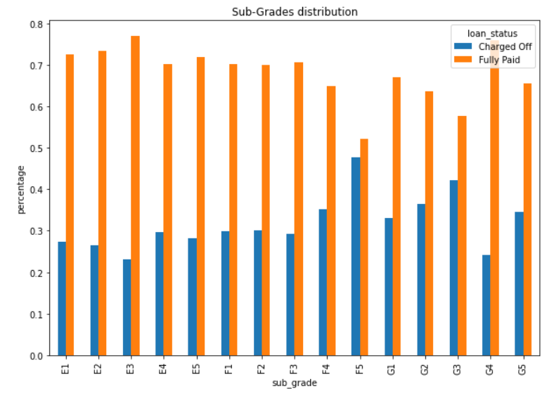
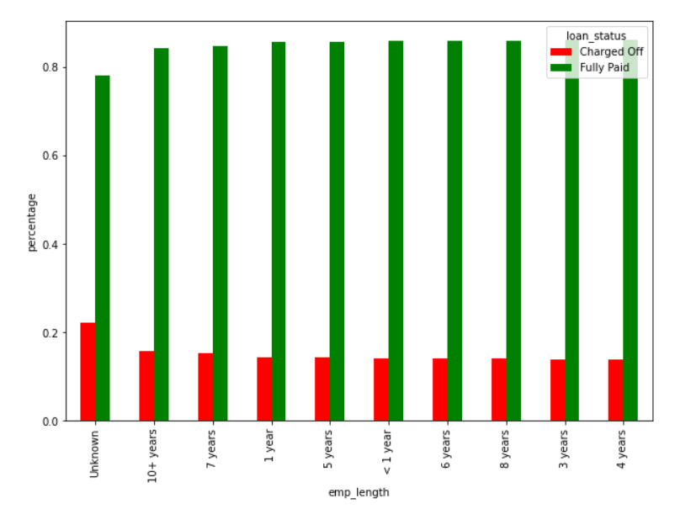
Bi-variate and Segmented analysis
If we look into subgrades F5 and G3 have more than 40 percent charged off loans.
Employment length “unknown” has a 20 percent of charged off loans.

Slide 10
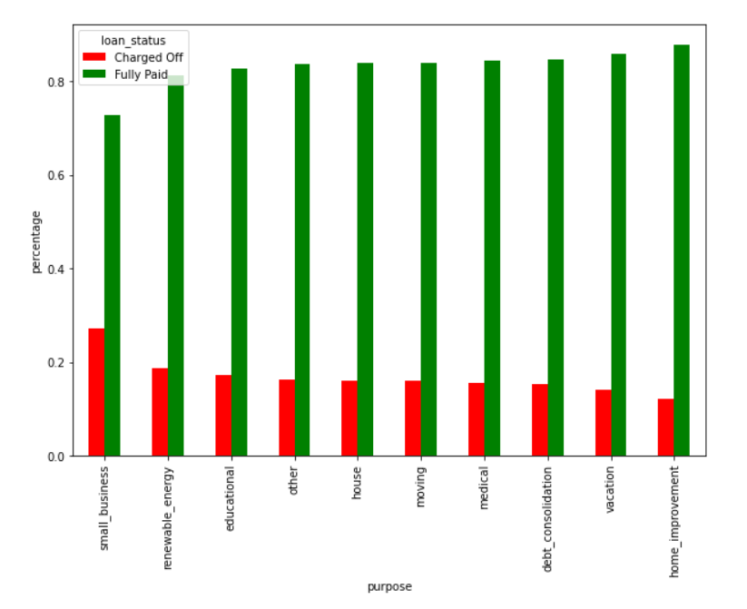
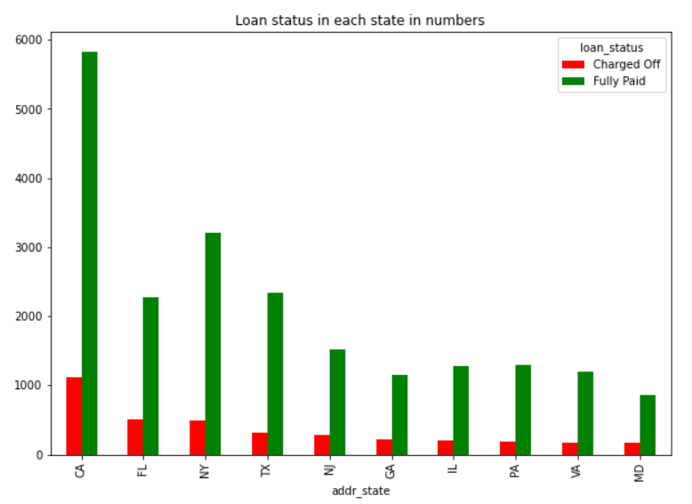
Bi-variate and Segmented analysis
Loans taken for Small business has a high percentage of charge off's.
NE State has the highest charged-off percentage(almost 60 percent).
CA State has a large number of charged-off loans

Slide 11
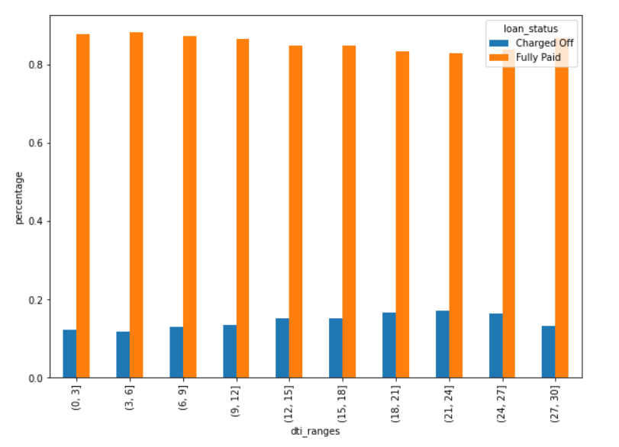
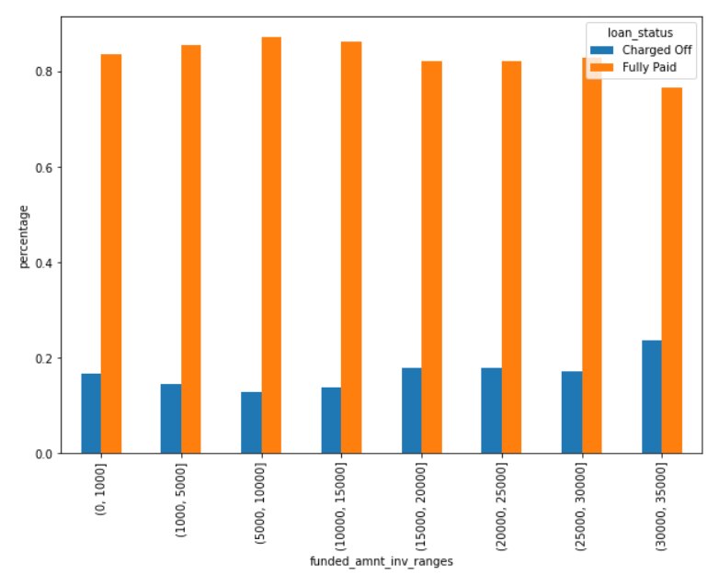
Bi-variate and Segmented analysis
If pub_rec_bankruptcies is high then also there is more chance of being Charged off.
Charge-off percentage is slightly high(~2-4) for DTI range is between 15 to 27.
Charge-off is slightly high if the loan amount is greater than 30K.

Slide 12
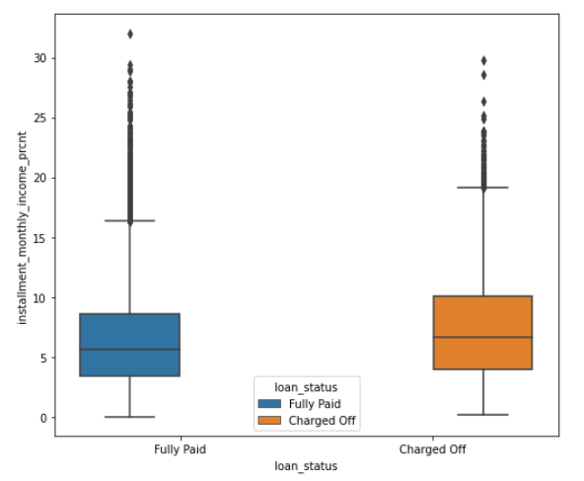
Feature Engineering
Calculating the difference amount of funded_amnt and funded_amnt_inv. Issuing more/less loan amount than approved amount doesn't have any effect on charged off.
Calculated the percentage of installment in monthly income. If the Installment to Monthly income percentage is more than ~8%, the chances of charge off increases

Slide 13
Conclusion
Lending club can consider below factors to decrease the Charge off percentage.
Interest rate for 60 months loan term can be reduced.
Should not give more loans if Revolving line utilization rate is higher.
Should issue loans carefully for certain grades which has higher charge off percentage.
Should not give more loans to people from NE state as they have ~60% charge off’s.
Should also reduce the number of loan for CA State as it has more number of charge off’s.

